Slide 1

Python GUI
Tkinter module

Slide 2
Introduction
To create a tkinter Python app:
Importing the module – tkinter
Create the main window (container)
Add any number of widgets to the main window
Apply the event Trigger on the widgets
widgets.
from tkinter import *
import tkinter as tk

Slide 3
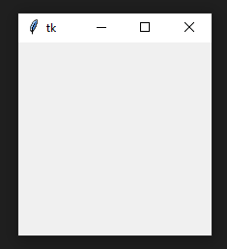
Creating a Window
from tkinter import *
window = Tk() # instantiate an instance of a window window.mainloop() # place window on computer screen, listen for events
import tkinter as tk
window = tk.Tk()
window.mainloop()

Slide 4
Tkinter Modules
tkinter
Main Tkinter module.
tkinter.colorchooser
Dialog to let the user choose a color.
tkinter.commondialog
Base class for the dialogs defined in the other modules listed here.
tkinter.filedialog
Common dialogs to allow the user to specify a file to open or save.
tkinter.font
Utilities to help work with fonts.
tkinter.messagebox
Access to standard Tk dialog boxes.
tkinter.scrolledtext
Text widget with a vertical scroll bar built in.
tkinter.simpledialog
Basic dialogs and convenience functions.
tkinter.ttk
Themed widget set introduced in Tk 8.5, providing modern alternatives for many of the classic widgets in the main tkinter module.
from tkinter import *
from tkinter import messagebox #import messagebox library

Slide 5
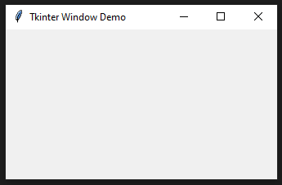
Changing the Window Title
To change the window’s title, you use the title() method like this:
import tkinter as tk
root = tk.Tk()
root.title('Tkinter Window Demo')
root.mainloop()

Slide 6
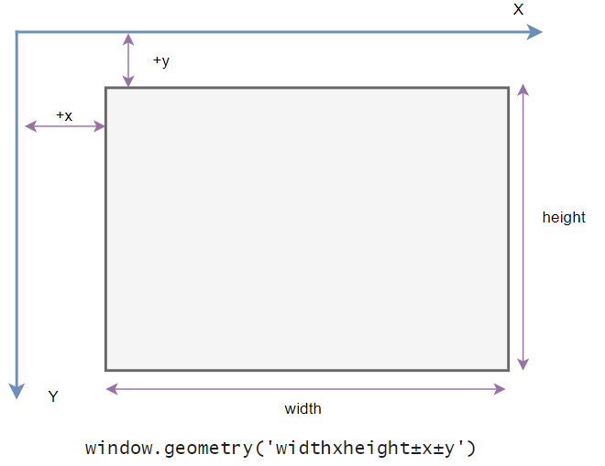
Changing Window Size and Location
In Tkinter, the position and size of a window on the screen is determined by its geometry.
The following shows the geometry specification:

Slide 7
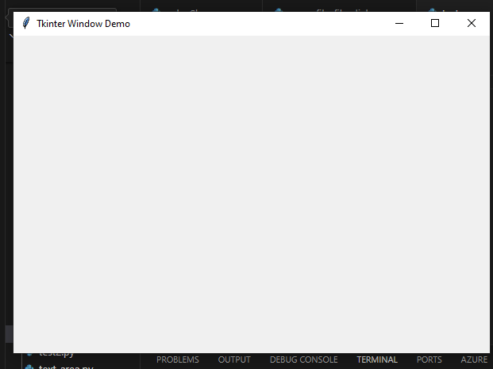
Changing Window Size and Location
import tkinter as tk
root = tk.Tk()
root.title('Tkinter Window Demo')
root.geometry('600x400+50+50')
root.mainloop()

Slide 8
Resizing Behavior
By default, you can resize the width and height of a window. To prevent the window from resizing, you can use the resizable() method:
window.resizable(width,height)
The following shows how to make the window with a fixed size:
import tkinter as tk
root = tk.Tk()
root.title('Tkinter Window Demo')
root.geometry('600x400+50+50')
root.resizable(False,False)
root.mainloop()
When a window is resizable, you can specify the minimum and maximum sizes using the minsize() and maxsize() methods:

Slide 9
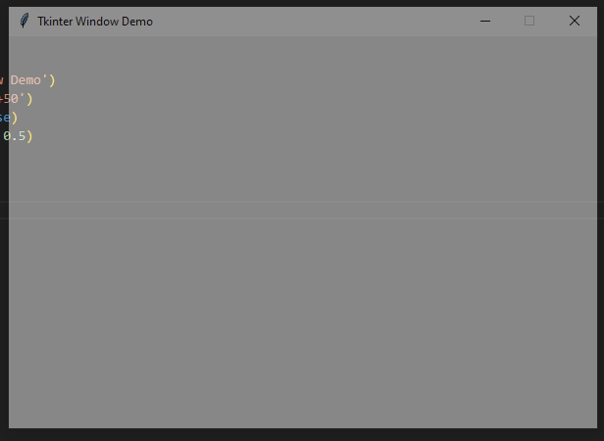
Transparency
Tkinter allows you to specify the transparency of a window by setting its alpha channel ranging from 0.0 (fully transparent) to 1.0 (fully opaque):
import tkinter as tk
root = tk.Tk()
root.title('Tkinter Window Demo')
root.geometry('600x400+50+50')
root.resizable(False, False)
root.attributes('-alpha', 0.5)
root.mainloop()

Slide 10
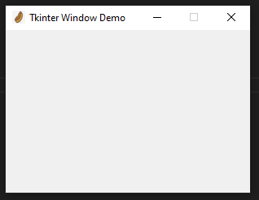
Changing the default Icon
import tkinter as tk
root = tk.Tk()
root.title('Tkinter Window Demo')
root.geometry('300x200+50+50')
root.resizable(False, False)
root.iconbitmap('hotdog.ico')
root.mainloop()

Slide 11
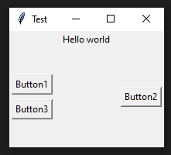
from tkinter import *
root = Tk()
root.geometry("200x150")
frame = Frame(root)
frame.pack()
leftframe = Frame(root)
leftframe.pack(side=LEFT)
rightframe = Frame(root)
rightframe.pack(side=RIGHT)
label = Label(frame, text = "Hello world")
label.pack()
button1 = Button(leftframe, text = "Button1")
button1.pack(padx = 3, pady = 3)
button2 = Button(rightframe, text = "Button2")
button2.pack(padx = 3, pady = 3)
button3 = Button(leftframe, text = "Button3")
button3.pack(padx = 3, pady = 3)
root.title("Test")
root.mainloop()
FRAME

Slide 12
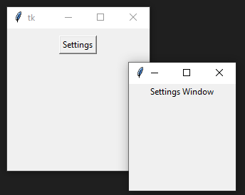
from tkinter import *
def NewWindow():
window = Toplevel()
window.geometry('150x150')
newlabel = Label(window, text = "Settings Window")
newlabel.pack()
root = Tk()
root.geometry('200x200')
myframe = Frame(root)
myframe.pack()
mybutton = Button(myframe, text = "Settings", command = NewWindow)
mybutton.pack(pady = 10)
root.mainloop()
TopLevel

Slide 13
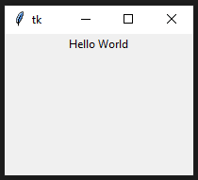
Label
from tkinter import *
root = Tk()
root.geometry("200x150")
frame = Frame(root)
frame.pack()
var = StringVar()
var.set("Hello World")
label = Label(frame, textvariable = var )
label.pack()
root.mainloop()

Slide 14
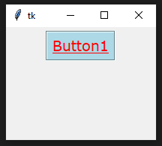
BUTTON
from tkinter import *
def set():
print("Hello World")
root = Tk()
root.geometry("200x150")
frame = Frame(root)
frame.pack()
button = Button(frame, text = "Button1", command = set,
fg = "red",
font = "Verdana 14 underline",
bd = 2,
bg = "light blue",
relief = "groove")
button.pack(pady = 5)
root.mainloop()

Slide 15
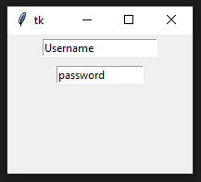
ENTRY
from tkinter import *
root = Tk()
root.geometry("200x150")
frame = Frame(root)
frame.pack()
my_entry = Entry(frame, width = 20)
my_entry.insert(0,'Username')
my_entry.pack(padx = 5, pady = 5)
my_entry2 = Entry(frame, width = 15)
my_entry2.insert(0,'password')
my_entry2.pack(padx = 5, pady = 5)
root.mainloop()

Slide 16
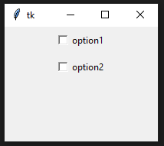
Check Button
from tkinter import *
root = Tk()
root.geometry("200x150")
frame = Frame(root)
frame.pack()
Var1 = IntVar()
Var2 = IntVar()
ChkBttn = Checkbutton(frame, width = 15, variable = Var1,text="option1")
ChkBttn.pack(padx = 5, pady = 5)
ChkBttn2 = Checkbutton(frame, width = 15, variable = Var2,text="option2")
ChkBttn2.pack(padx = 5, pady = 5)
root.mainloop()

Slide 17
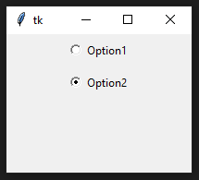
Radio Button
from tkinter import *
root = Tk()
root.geometry("200x150")
frame = Frame(root)
frame.pack()
Var1 = StringVar()
RBttn = Radiobutton(frame, text = "Option1", variable = Var1,
value = 1)
RBttn.pack(padx = 5, pady = 5)
RBttn2 = Radiobutton(frame, text = "Option2", variable = Var1,
value = 2)
RBttn2.pack(padx = 5, pady = 5)
root.mainloop()

Slide 18
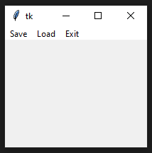
from tkinter import *
def save():
#Code to be written
pass
def load():
#Code to be written
pass
root = Tk()
root.geometry("200x150")
frame = Frame(root)
frame.pack()
mainmenu = Menu(frame)
mainmenu.add_command(label = "Save", command= save)
mainmenu.add_command(label = "Load", command= load)
mainmenu.add_command(label = "Exit", command= root.destroy)
root.config(menu = mainmenu)
root.mainloop()
MENU

Slide 19
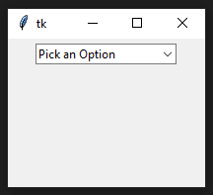
ComboBox
from tkinter import *
from tkinter import ttk
root = Tk()
root.geometry("200x150")
frame = Frame(root)
frame.pack()
vlist = ["Option1", "Option2", "Option3",
"Option4", "Option5"]
Combo = ttk.Combobox(frame, values = vlist)
Combo.set("Pick an Option")
Combo.pack(padx = 5, pady = 5)
root.mainloop()

Slide 20
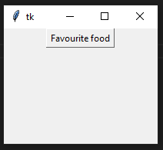
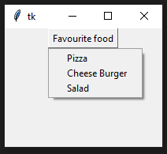
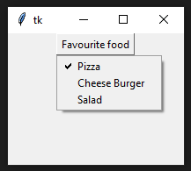
from tkinter import *
root = Tk()
root.geometry("200x150")
frame = Frame(root)
frame.pack()
MenuBttn = Menubutton(frame, text = "Favourite food", relief = RAISED)
Var1 = IntVar()
Var2 = IntVar()
Var3 = IntVar()
Menu1 = Menu(MenuBttn, tearoff = 0)
Menu1.add_checkbutton(label = "Pizza", variable = Var1)
Menu1.add_checkbutton(label = "Cheese Burger", variable = Var2)
Menu1.add_checkbutton(label = "Salad", variable = Var3)
MenuBttn["menu"] = Menu1
MenuBttn.pack()
root.mainloop()
Menu Button

Slide 21
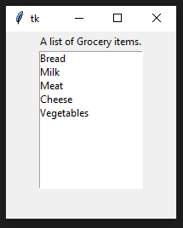
from tkinter import *
root = Tk()
root.geometry("200x220")
frame = Frame(root)
frame.pack()
label = Label(root,text = "A list of Grocery items.")
label.pack()
listbox = Listbox(root)
listbox.insert(1,"Bread")
listbox.insert(2, "Milk")
listbox.insert(3, "Meat")
listbox.insert(4, "Cheese")
listbox.insert(5, "Vegetables")
listbox.pack()
root.mainloop()
List Box

Slide 22
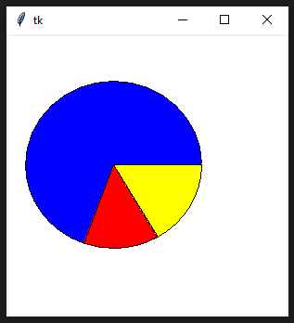
CANVAS
from tkinter import *
root = Tk()
frame=Frame(root,width=300,height=300)
frame.pack()
canvas = Canvas(frame,bg='white', width = 300,height = 300)
coordinates = 20, 50, 210, 230
arc = canvas.create_arc(coordinates, start=0, extent=250, fill="blue")
arc = canvas.create_arc(coordinates, start=250, extent=50, fill="red")
arc = canvas.create_arc(coordinates, start=300, extent=60, fill="yellow")
canvas.pack()
root.mainloop()

Slide 23
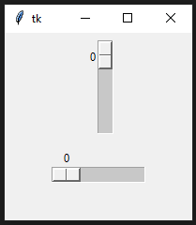
SCALE
from tkinter import *
root = Tk()
root.geometry("200x200")
frame = Frame(root)
frame.pack()
Scala = Scale(frame, from_=0, to=10)
Scala.pack(padx=5, pady=5)
Scala2 = Scale(frame, from_=0, to=10, orient=HORIZONTAL)
Scala2.pack(padx=5, pady=5)
root.mainloop()

Slide 24
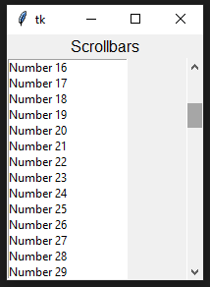
Scroll Bar
from tkinter import *
root = Tk()
root.geometry("200x250")
mylabel = Label(root, text ='Scrollbars', font = "30")
mylabel.pack()
myscroll = Scrollbar(root)
myscroll.pack(side = RIGHT, fill = Y)
mylist = Listbox(root, yscrollcommand = myscroll.set )
for line in range(1, 100):
mylist.insert(END, "Number " + str(line))
mylist.pack(side = LEFT, fill = BOTH )
myscroll.config(command = mylist.yview)
root.mainloop()

